Slide 1

PROJECT
Avancer Software Solutions Pvt. Ltd

Slide 2

TITLE
Healthcare Predictor using ML Algorithm

Slide 3
AGENDA
Abstract & Objective
1
Literature & Existing Cons.
2
Proposed Work
3
Modules Info. & Requirements
4
Demo & Paper Proof
5
References
6

Slide 4
ABSTRACT
Healthcare is the maintenance or improvement of health via the prevention, diagnosis, and treatment of disease, illness, injury, and other physical and mental impairments in human beings.
Health care is generally delivered by health professionals (providers or practitioners) in allied health fields.
It includes work done in providing primary care, secondary care, and tertiary care, as well as in public health.
Sometimes, it might have happened so many times that you or someone yours need doctors help immediately, but they are not available due to some reason.
At that time we need a online care and support.

Slide 5
OBJECTIVES
So, we are proposing a system named the Healthcare Prediction system.
It is an end user support and online consultation project.
It allows users to get instant guidance on their health issues through an intelligent health care system online.
Here we are using the machine learning technique mainly the supervised learning techniques to make the system more intelligent.
Initially, the system is fed with various symptoms and the disease or illness associated with those.
Then it trains the model (mainly random forest model) on symptoms on dataset and tune its parameters.
Finally the system allows user to share their symptoms and issues then it predict most accurate illness that associated.

Slide 6
LITERATURE
Combination data mining methods with new medical data to predicting outcome of Coronary Heart Disease – “Yanwei Xing, Jie Wang” , “Zhihong Zhao”:
They started prediction on Coronary heart disease (CHD).
The goal of this paper is to develop data mining algorithms for predicting survival of CHD patients based on 1000 cases.
They used SVM as model to predict the CHD with an accuracy of 79.1%.
They also tried using Neural networks which gives a poor accuracy than SVM.
An Incremental Decision Tree Learning Methodology Regarding Attributes in Medical Data Mining- “SAM CHAO”, “FAI WONG”:
In this paper, they used i+Learning (Intelligent, Incremental and Interactive Learning) theory is proposed to complement the traditional incremental decision tree learning algorithms

Slide 7
LITERATURE
But, many researches have been reported that decision trees with incremental learning ability, which is able to address the learning task with a stream of training instances only.
APRIORI algorithm based medical data mining for frequent disease identification – Gitanjali:
Here data mining is used to analyse a huge data from different perspectives and summarizing it into useful information.
In this paper, authors developed a method to identify frequency of diseases in particular geographical area at given time period with the aid of association rule based Apriori data mining technique.
Some researchers worked previously on predictive analytics in health care to predict the chronic kidney diseases using decision tree algorithm. (CSIT-2016 paper).

Slide 8
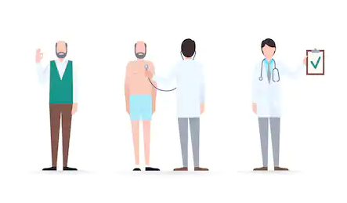
EXISTING CONS
The system is not fully automated, it needs doctors for full diagnosis.
We have to go to hospital for every small reason.
Disease diagnosis time is more.
User can’t discuss their illness to doctors immediately.
User need to wait for doctor until doctor come.
ML models cannot have user friendly nature to use by user.

Slide 9

PROPOSED WORK

Slide 10
PROPOSED WORK
Here we propose a system that allows users to get instant guidance on their health issues through an intelligent health care model online. (web application)
The machine learning model is fed with various symptoms and the disease or illness associated with it.
The front end interface allows user to share their symptoms and issues.
It then processes user’s symptoms to check for various illness that could be associated with it.
Here we use Random Forest a ensemble learning algorithm to predict the most accurate illness that could be associated with patient’s symptoms.

Slide 11
PROPOSED WORK
If the system is not able to provide suitable results means it informs the user about the type of disease or disorder it feels.
If user’s symptoms do not exactly match any disease in dataset developed, is shows the diseases user could probably have judging by his/her symptoms.
It also consists of doctor address, contacts along with Feedback and administrator dashboard for system operations.

Slide 12
MODULES INFO.
Anaconda:
Anaconda is a free and open-source distribution. It supports the Python and R programming languages for scientific computing and aims to simplify package management.
It is the industry standard for developing, testing, and training on a single machine, enabling individual data scientists to work on it.
In this project we use almost most of the machine learning tools like Scikit-Learn, Pandas, NumPy and SciPy which is pre-installed in anaconda and PyMySQL to deal with MySQL server.
Python:
Python is a general purpose and high-level programming language. You can use Python for developing desktop GUI applications, websites, Machine learning applications and web applications.

Slide 13
MODULES INFO.
So, in this Health care predictor we use Python as a language to implement both machine learning work and website work with the help of flask framework.
Scikit-Learn:
Sk-learn an open source Python library that implements a range of machine learning works like pre-processing, cross validation and tuning with its rich algorithms using a unified interface on the data provided and accumulated in the system to generate various models.
In our project we use Pandas module to read the csv file which contains comma separated values and convert that into a pandas DataFrame.
Scikit-Learn simple and efficient algorithms helps to split the data set to test and train samples for compiling under various algorithms to improve the accuracy by opting the best supervised model.
The SVM, Random forest, statistical modelling, decision tree analysis and logistic regression can be carried out in one place making it simple and robust for our project. |

Slide 14
REQUIREMENTS
OS : WINDOWS 10
RAM : 4GB or more
Script : Python 3.5+
Environment : Anaconda 5.3
Libraries : NumPy 1.16.0, Pandas 1.0.3, Matplotlib 3.2.1, Seaborn 0.10.1, Scikit-Learn 0.2
Front End : HTML5, CSS3
Database : MySQL 6.0

Slide 15
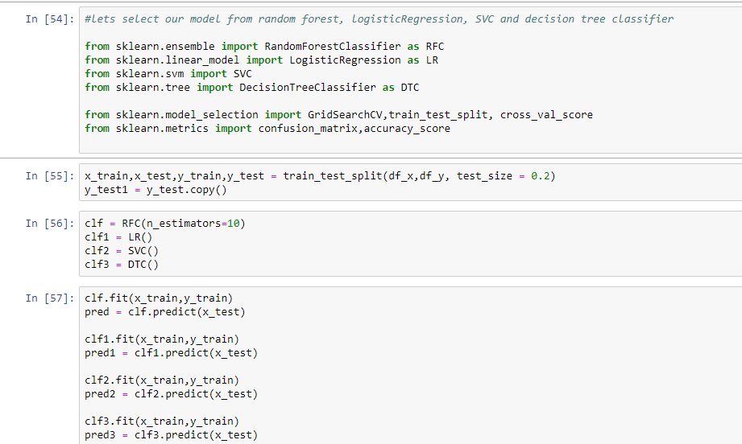
DEMO OF IMPLEMENTATION
SAMPLE CODE SNIPPET

Slide 16
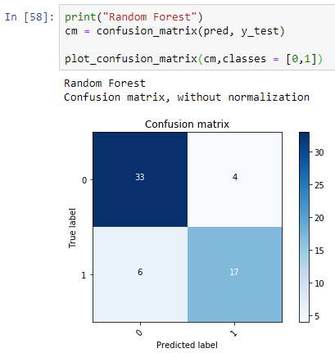
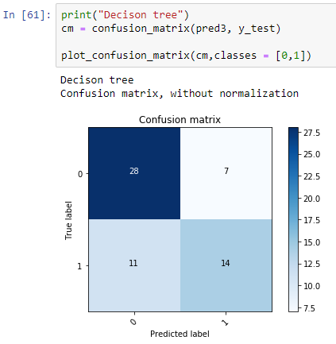
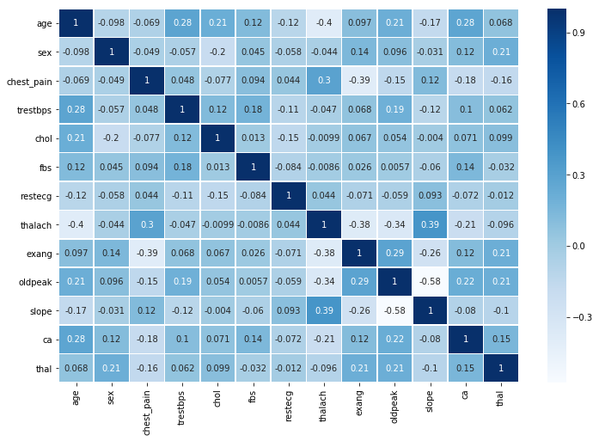
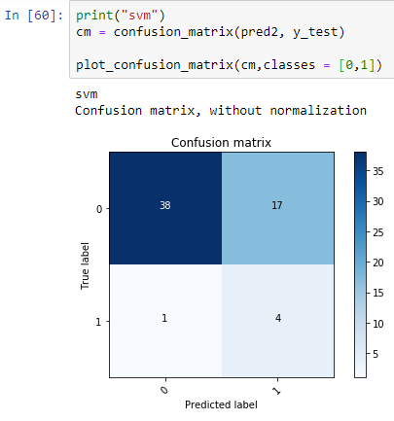
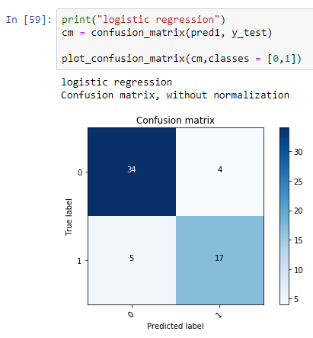
CORRELATION GRAPH ON DATASET
CONFUSION MATRIX OF 4 MODELS

Slide 17
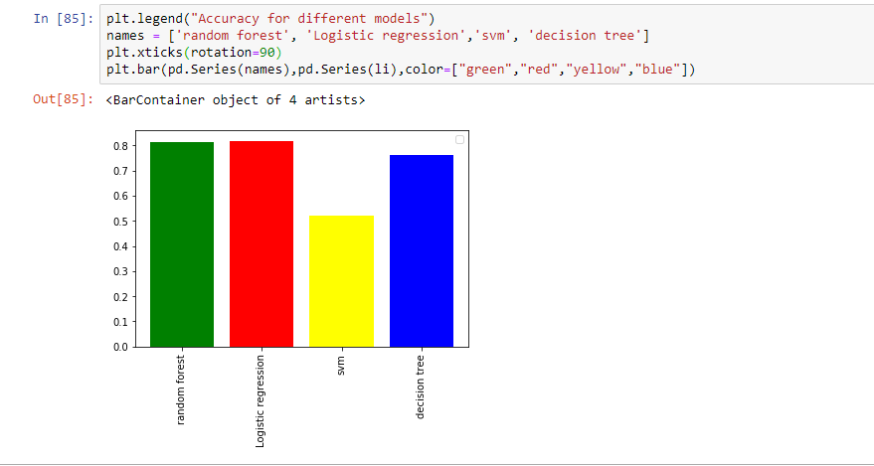
ACCURACY BAR GARPH

Slide 18
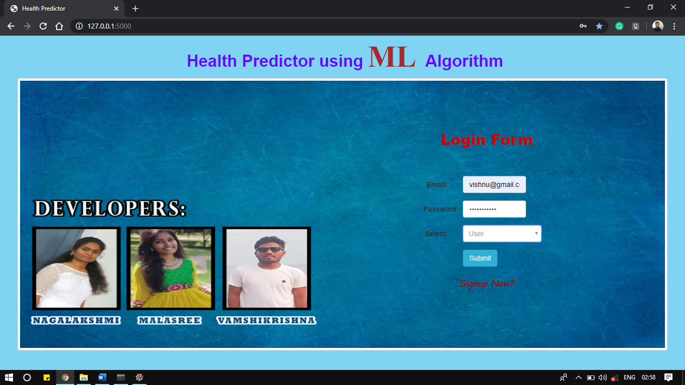
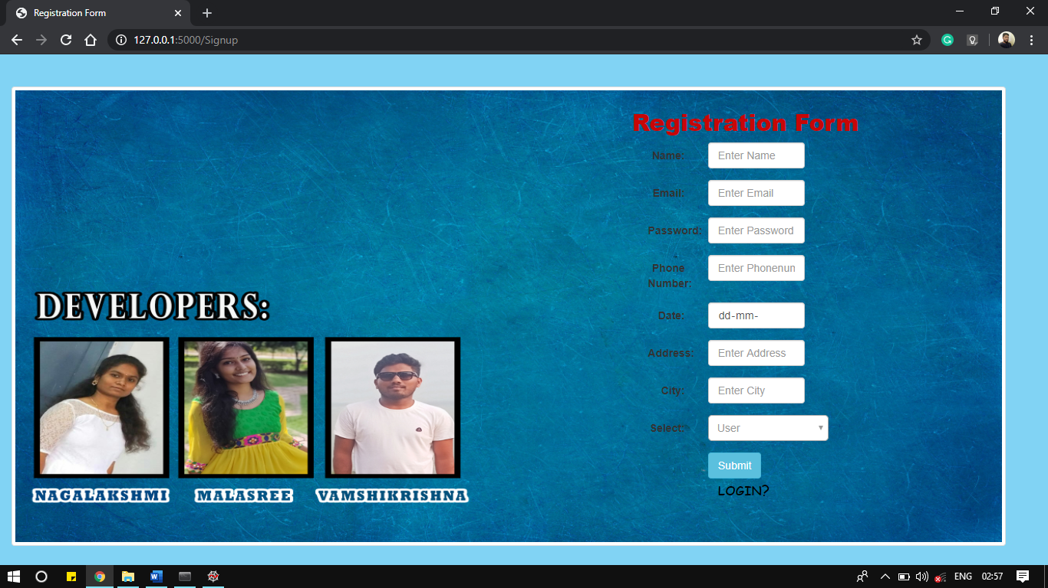
LOGIN PAGE
REGISTRATION PAGE

Slide 19
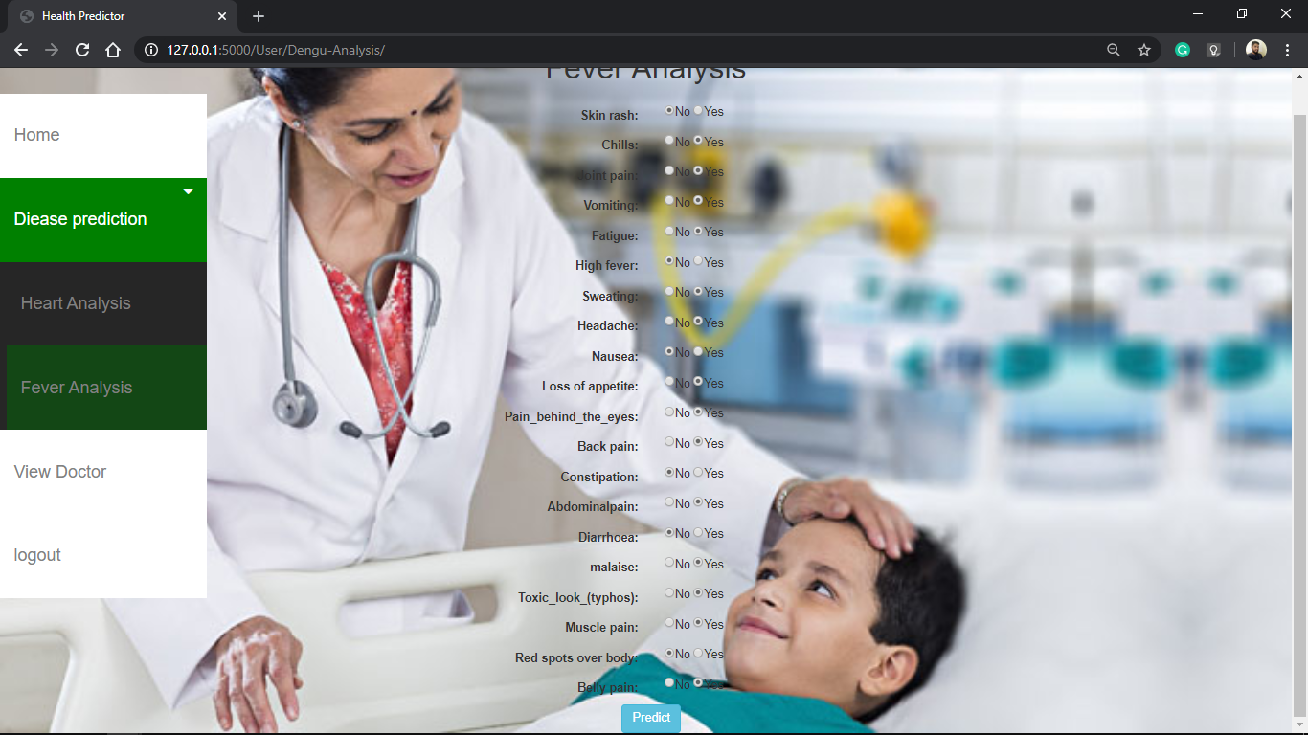
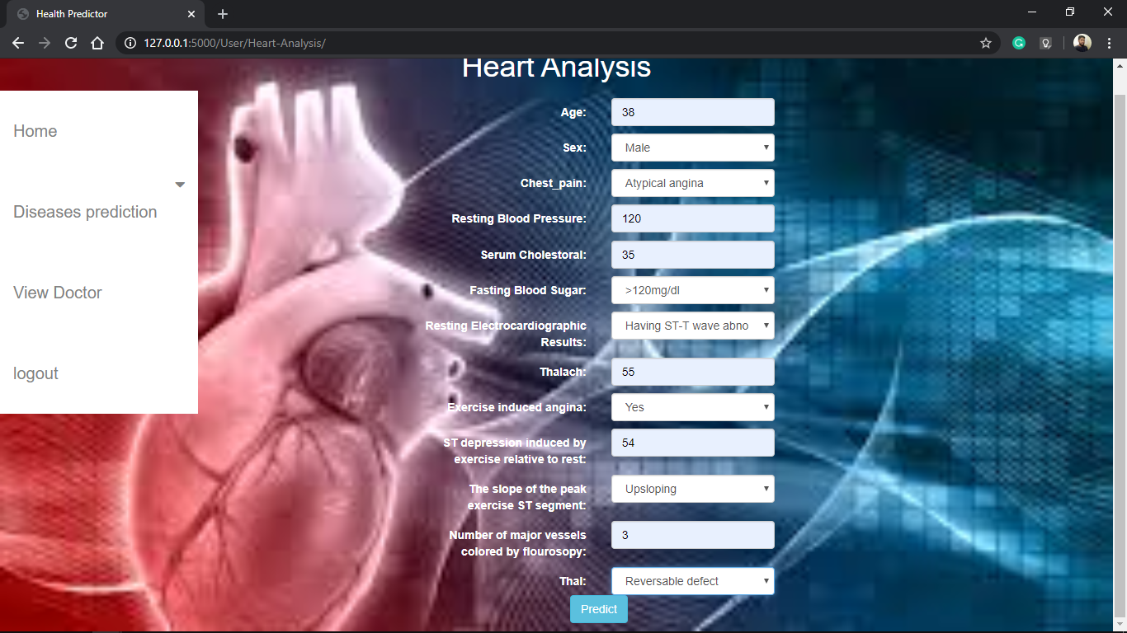
DISEASE PREDICTION PAGE
HEART ANALYSIS PREDICTION PAGE

Slide 20
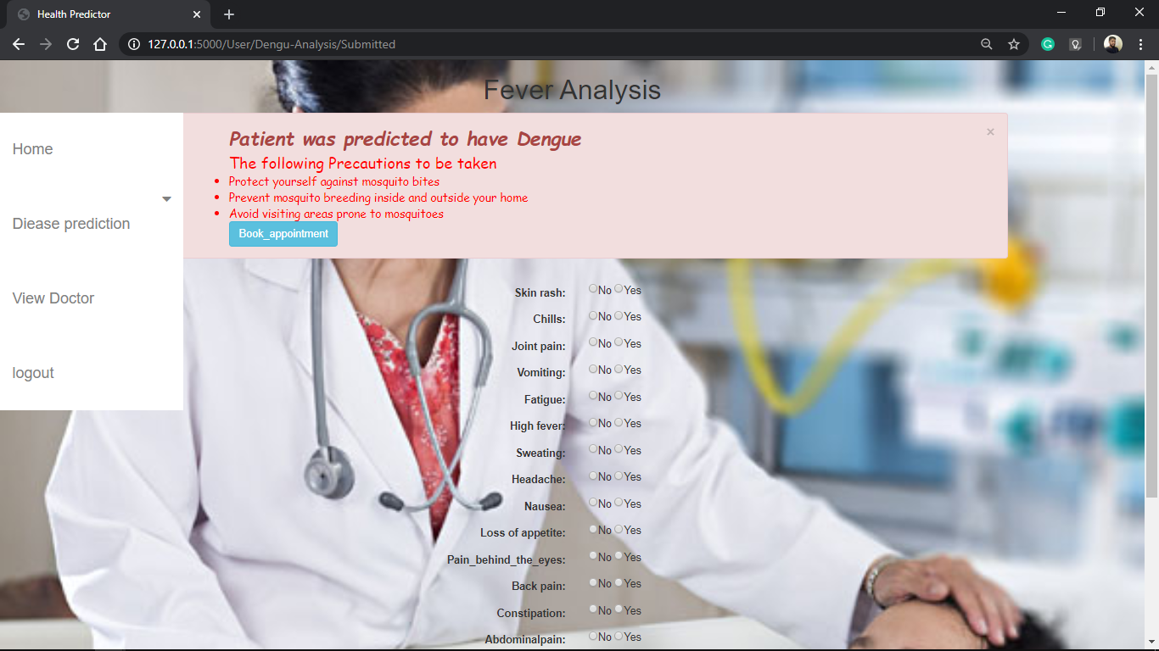
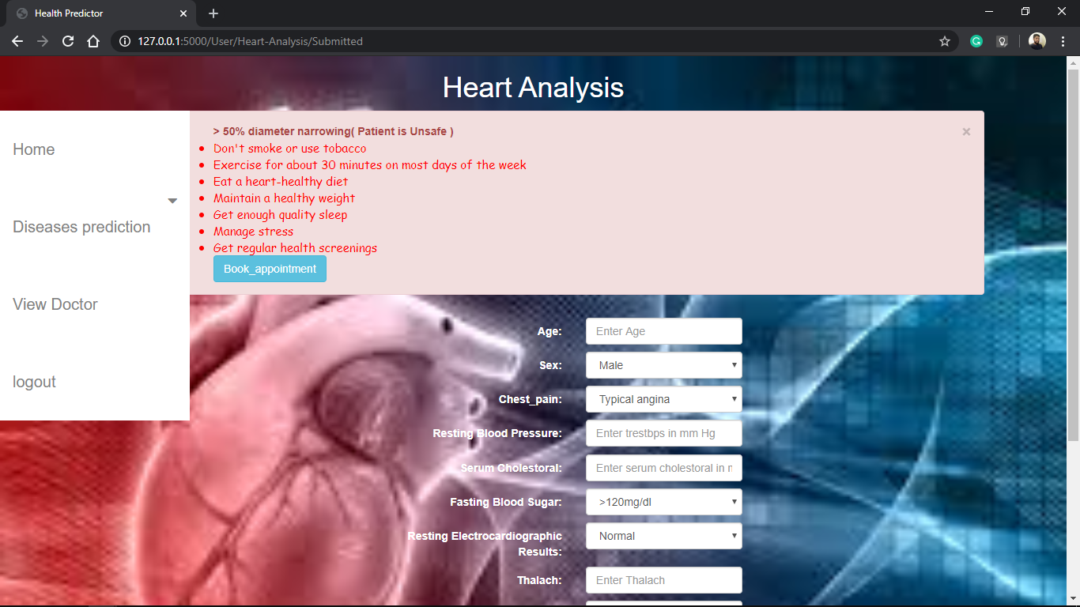
DISEASE PRECAUTIONS PAGE
HEART PRECAUTIONS PAGE

Slide 21
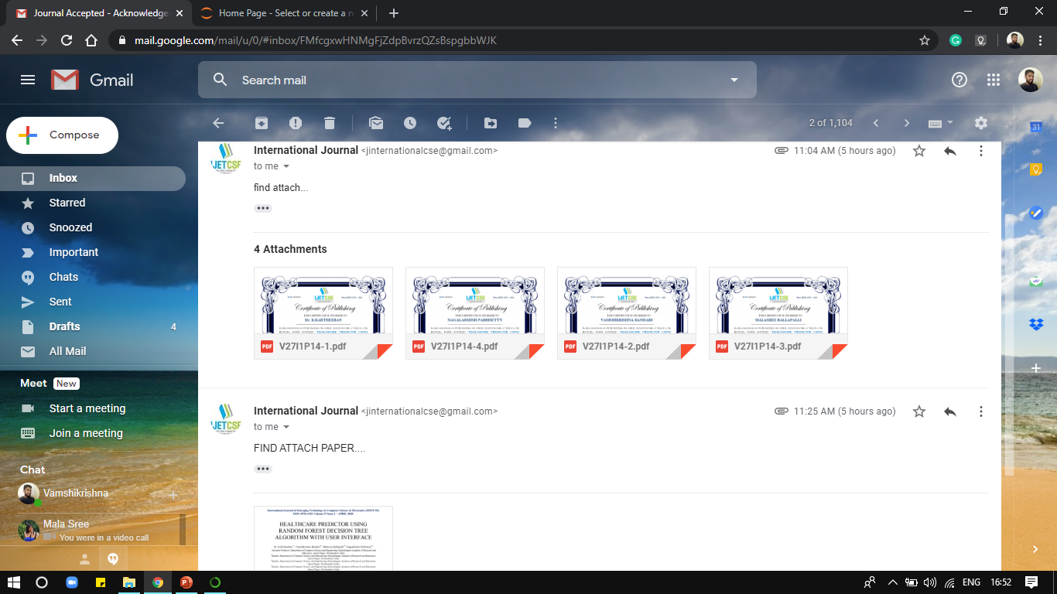
PAPER PROOF

Slide 22
REFERENCES
Shaikh Abdul Hannan, A.V. Mane, R. R. Manza, and R. J. Ramteke, Dec 2010, “Prediction of Heart Disease Medical Prescription using Radial Basis Function”, IEEE International Conference on Computational Intelligence and Computing Research (ICCIC)
Mrudula Gudadhe, Kapil Wankhade, and Snehlata Dongre, Sept 2010,“Decision Support System for Heart Disease Based on Support Vector Machine and Artificial Neural Network”, International Conference on Computer and Communication Technology (ICCCT),DOI:10.1109/ICCCT.2010.5640377, 17-19.
http://www.heart.org/HEARTORG/Conditions/HeartAttack/WarningSignsofa HeartAttack/Warning-Signs-of-aHeartAttack_UCM_002039_Article.jsp#.WNpKgPl97IU.
www.who.int/cardiovascular_diseases/en/. http://food.ndtv.com/health/world-heart-day-2015-heart-disease-in-india-is-agrowing-concern-ansari-1224160.

Slide 23
REFERENCES
Wikipedia on cardiovascular diseases : https://en.wikipedia.org/wiki/Cardiovascular_disease.
AH Chen, SY Huang, PS Hong, CH Cheng, and EJ Lin,2011, “HDPS: Heart Disease Prediction System”, Computing in Cardiology, ISSN: 0276-6574, pp.557- 560.
Manpreet Singh, Levi Monteiro Martins, Patrick Joanis, and Vijay K. Mago,2016, “Building a Cardiovascular Disease Predictive Model using Structural Equation Model & Fuzzy Cognitive Map”, IEEE International Conference on Fuzzy Systems (FUZZ), pp. 1377-1382.
Kaggle – A data set collection hub.

Slide 24
TEAM
Dr K Kartheeban (Guide)
Associate Prof. - CSE
“Alone we can do so little, together we can do Wonders.”
--Helen Keller
Malasree
IV-CSE-B
Nagalakshmi
IV-CSE-B
Vamshikrishna
IV-CSE-C

Slide 25

Venue:
Department of Computer science
Kalasalingam Academy of Research and Education
Krishnankoil, Tamilnadu.

